Slide 1


Affiliated to - JNTUH Approved by - AICTE EAMCET / ECET CODE:KPRT
KOMMURI PRATAP REDDY INSTITUTE OF TECHNOLOGY
Predictive Modeling for Crop Yield Estimation: Machine Learning Classifier Comparison
By
GUNDA VIDYASRI – 22RA1A6693
RANDHI RAM KIRAN – 22RA1A6659
ARELLA VISHNU VARDHAN – 22RA1A6695
MADUGU YUVARAJ – 22RA1A6697
Guide: Prof.T.Ravinder

Slide 2
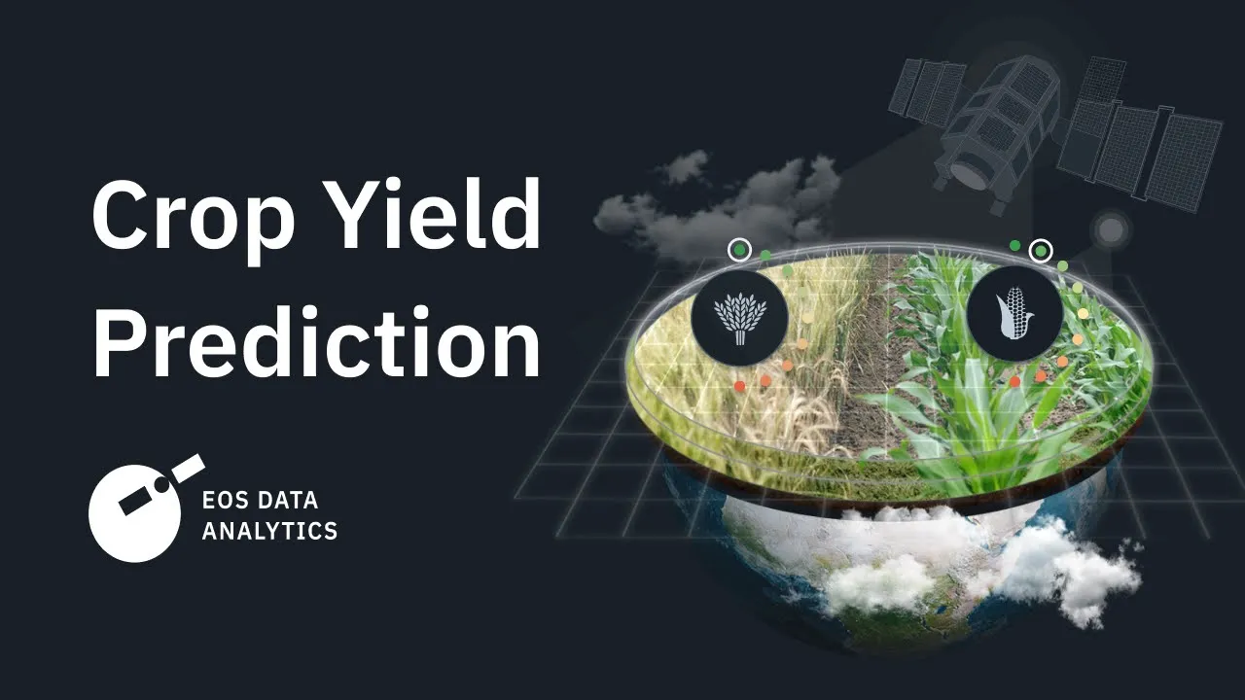
CONTENTS
Abstract
Introduction
Problem definition
Traditional System
Limitations
Proposed System
Advantage
Result
Conclusion
References

Slide 3
ABSTRACTION
AIM:
This project aims to develop & compare various ML classifiers for the predictive modeling of crop yield estimation.
Accurate yield prediction is essential for agricultural planning, resource management, and ensuring food security.
We employ multiple machine learning classifiers, including logistic regression, support vector machines, to identify the most effective mode for this task.

Slide 4
* EXISITING PROBLEM:
-> Our approach integrates diverse datasets comprising historical crop yields, weather conditions, soil properties, and remote sensing data.
Motivation : Good growing crop Yeild
PROPOSED ALGORITHM:
. Data pre-processing techniques are applied to handle missing values,
normalize data, and perform feature selection to enhance model
performance
Each classifier is trained and validated using cross-validation to ensure robustness and generalizability.

Slide 5
INTRODUCTION
Agriculture is the most important sector and also the backbone of the Indian economy
In India , agricultural yield primarily depends on weather conditions.
By analyzing the soil and atmosphere at particular region best crop in order to have more crop yield and the net crop yield can be predicated.
Crop prediction, there are different techniques or algorithm, and with the help of those algorithms we can predict crop yield and also we are using random forest algorithm.
In india , there are several ways to increase the economic growth in the field of agriculture and also there are multiple ways to increase and improve the crop yield and the quality of the crop.

Slide 6
PROBLEM DEFININATION
The problem of predictive modeling for crop yield estimation using machine learning involves developing models that can accurately predict the quantity and possibly the quality of crops that will be harvested based on various input factors. These factors typically include historical data on crop yields, weather conditions, soil properties, and agricultural practices. The goal is to build robust models that can assist farmers and agricultural stakeholders in making informed decisions to optimize resources, mitigate risks, and enhance overall productivity.

Slide 7
Traditional Systems for Crop Yield Estimation
Traditional Systems for Crop Yield Estimation
Statistical Methods: These may include linear regression, time series analysis, or basic statistical models to analyze historical data and trends.
Expert Knowledge: Farmers' experience and agronomic expertise play a crucial role in estimating yields based on factors such as weather conditions, soil quality, pest infestations, and crop management practices.
Crop Simulation Models: These models simulate the growth of crops under various conditions, integrating factors like temperature, water availability, and soil nutrients to estimate yields.

Slide 8
Limitations
Predictive Modeling for Crop Yield Estimation: Machine Learning Classifier Comparison
1. Data Quality and Availability
2. Feature Selection and Engineering
3. Model import
4. Generalization to New Conditions
5. Temporal Dynamics
6. Model Selection Bias
7. Scalability and Efficiency

Slide 9
Proposed System:
The project aims to develop: a predictive model for crop yield estimation using machine learning classifiers.
Data Import and Preprocessing: Importing necessary libraries and the dataset (dataset.csv). It conducts initial data analysis, checking info, description, correlation, and null values. Data visualization is performed using seaborn to visualize the count plot of the target variable yield class.
Model Training: The dataset is split into training and testing sets using train test split. Two classifiers are trained:

Slide 10
Orthogonal Matching Pursuit (OMP) Classifier: An instance of Orthogonal Matching Pursuit from scikit-learn is used.
Calibrated Classifier CV: It's a calibrated version of Logistic Regression, trained with Calibrated Classifier CV from scikit-learn.
Model Evaluation: For both classifiers, performance metrics such as accuracy, precision, recall, and F1-score are calculated using a custom function performance metrics. Classification report and confusion matrix are generated for each classifier to evaluate its performance visually.
Model Persistence: Trained models are saved and loaded if the model files exist, using numpy ‘s np. save and np load.
Model Prediction on Test Data: Another dataset (test.csv) is loaded for prediction. The same preprocessing steps are applied to this dataset.

Slide 11
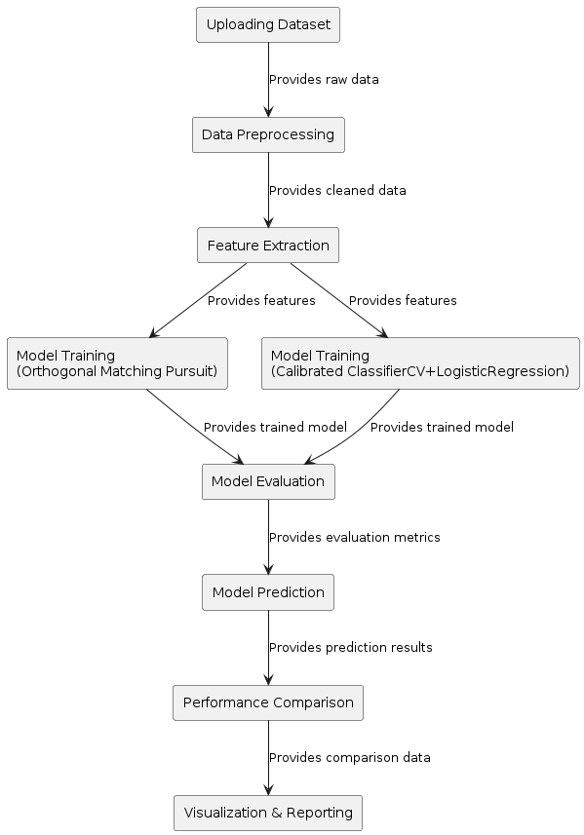
Fig. : Block Diagram of Proposed System.

Slide 12
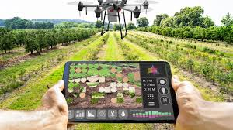
Advantages
An accurate crop yield prediction model can help farmers to decide on what to grow and when to grow.
Timely import and export decisions can be made based on accurate predications.
Farmers can utilize the yield prediction to make knowledgeable management and financial decisions .

Slide 13
SYSTEM REQUIREMENTS
The functional requirements or the overall description documents include the product perspective and features, operating system and operating environment, graphics requirements, design constraints and user documentation.
Python IDLE 3.7 version (or)
Anaconda 3.7 (or)
Jupiter (or)
Google co lab.

Slide 14
Hardware Requirements
Minimum hardware requirements are very dependent on the particular software being developed by a given Enthought Python / Canopy / VS Code user. Applications that need to store large arrays/objects in memory will require more RAM, whereas applications that need to perform numerous calculations or tasks more quickly will require a faster processor.
Operating system : Windows, Linux
Processor : minimum intel i3
Ram : minimum 4 GB
Hard disk : minimum 250GB

Slide 15
Result and discussion
The project aims to develop a robust system for predicting crop yields by employing and comparing various machine learning classifiers. This implementation involves several crucial steps, each contributing to the overall accuracy and effectiveness of the predictive model.
Data Preprocessing: Data preprocessing is a vital step that ensures the dataset is clean and suitable for analysis. It involves several sub-steps:
Feature Extraction: This step is crucial for enhancing the model's predictive power and efficiency.
Data Splitting :To evaluate the model's performance, the dataset is split into training and testing sets.
Performance Evaluation: The performance of the models is evaluated using various metrics they are Accuracy , Precision ,Recall, F1-Score, Confusion Matrix etc…

Slide 16
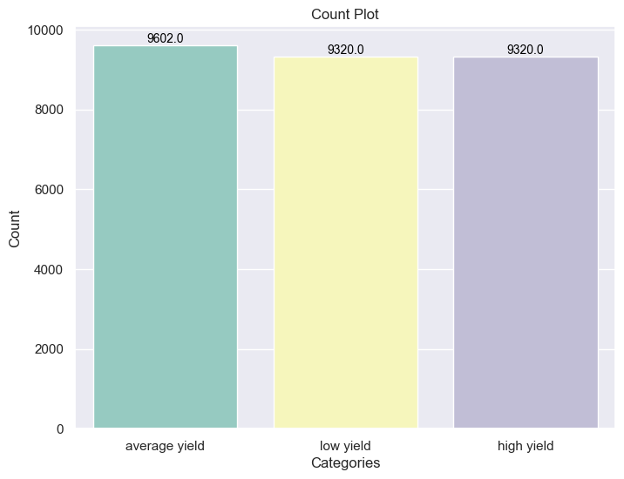
Fig.: Count plot for the Uploaded dataset.

Slide 17
CONCLUSION
The project on predictive crop yield estimation using machine learning classifiers has demonstrated promising results in accurately predicting crop yield classes based on various input features.
Through the utilization of advanced machine learning algorithms such as Orthogonal Matching Pursuit (OMP) and Calibrated Classifier CV with logistic regression, the models have been trained and evaluated on a comprehensive dataset containing information on factors like area, crop type, year, yield, rainfall, pesticides usage, and average temperature.
The performance evaluation of these models has shown substantial precision, recall, F1-score, and accuracy, indicating their effectiveness in classifying crop yield classes. The confusion matrices provide detailed insights into the models' predictive capabilities and their ability to differentiate between different yield classes.

Slide 18
Future Scope:
The future scope of predictive crop yield estimation using machine learning encompasses several exciting advancements and opportunities. Firstly, as the volume of agricultural data continues to grow, integrating more diverse data sources such as satellite imagery, remote sensing, and IoT sensor data will enhance the accuracy and granularity of predictions. The inclusion of real-time data feeds will enable dynamic updates to yield estimates, allowing farmers to respond swiftly to changing conditions.

Slide 19
REFERENCES
[1] Sulaiman , M. A. (2020). Evaluating Data Mining Classification Methods Performance in the Internet of Things Applications. Journal of Soft Computing and Data Mining, 1(2), 11-25.
[2] Medar , R. A., &Raj purohit , V. S. (2014). A survey on data mining techniques for crop yield prediction. International Journal of Advanced Research in Computer Science and Management Studies, 2(9), 59-64.
[3] Nathgosavi , V., &Patil, S. (2021). A Survey on Crop Yield Prediction using Machine Learning (No. 5238).Easy Chair .
[4] Zeebaree , D. Q., Haron , H., Abdulazeez, A. M., & Zeebaree , S. R. (2017). Combination of K-means clustering with Genetic Algorithm: A review. International Journal of Applied Engineering Research, 12(24), 14238-14245.

Slide 20
THANK YOU

